Slide 1
ELIMINATING COMPLINCE RISKS - DATA MASKING WITH AZURE

Slide 2
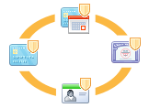
SECURITY THREATS
INTENTIONAL (FRAUD)
Ponemon institute study of 60 large organizations
Cost of cybercrime rose 26% to 11.6 Mil per company
The most costly:
Distributed Denial of Service (DDS)
Web-based attacks
Malicious Insiders
SEI Study
Of the 80 of internal fraud cases, 34 % involved Personally Identifiable Information
UNINTENTIONAL
Innocent insider is being set up by outsider with malicious code
Insider negligence or accidental disclosure ( loss of laptop)
The theft of an unencrypted laptop from an employee's car resulted
in a breach affecting more than 61,000 patients in 2010 in Cincinnaty
Data courtesy of www.inforisktoday.com

Slide 3
IT RESPONDS BY TIGHTENING SECURITY
Separation of environments
Tightened controls
Standards, policies, audits, drills, security framework
Due to increased security processes, development slows down
DEVELOPMENT LOOKS SOMEWHERE ELSE :
CLOUD = EASY PROVISIONNING = SPEED TO MARKET
SECURITY
Development
SPEED

Slide 4
IS CLOUD RISK FREE?
Avoiding The Hidden Costs of The Cloud (Symantec)
Of 3,236 companies :
40% exposed confidential info
25% suffered account takeover and digital theft
40% loss of data
23% fined for privacy violation
IT RESTRICTIONS
PRESSURE TO DEVELOP AT BREAKNECK SPEED
SECURTY BREACHES IN CLOUD –SLAs
HOW DO WE PROTECT DATA?
PUBLIC CLOUD BECOMES
DEVELOPMENT
SANDBOX

Slide 5
DOES IT MEAN WE SHOULD AVOID CLOUD DEVELOPMENT?
?
LETS TAKE A CLOSER LOOK AT DEVELOPMENT PROCESSES AND
DATA FLOWS ACROSS ENVIRONMENTS

Slide 6
BIG PICTURE : DIFFERENT COMPANIES –DIFFERENT NEEDS
STARTUP
0
There is no data in organization. Development speed is high. Developers create their own data with “insert” statements.
DEVELOPED ORGANIZATION
Data in other systems and in production. It is used to populate development environments. Speed of development slows down.
New Projects – add files and data feeds
Continuous Development – adds its own production data
Maintenance – no new features, no “inserts” any more
Migration – only production data, moving on

Slide 7
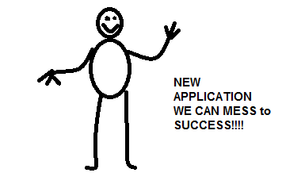
NEW DEVELOPMENT
When we start from Scratch, there is nothing and we can initially treat everything as if databases were code.
Your
Application
Your
Database
Copyright 2005 / Scott W. Ambler

Slide 8
NEW DEVELOPMENT
We create data with “INSERT” statements, saving them as code in Source Control.
Cloud – no Cloud makes no difference.
Yes, promote to production
Yes, promote to Staging
Yes, promote to the QA
SANDBOX:
Create master data
and test cases. test
QA:
Move new master data Run test cases
Staging / UAT:
Move New Master data, test for deployment
Do UAT
NO
errors?
NO
errors?
NO
errors?
Create a DDL and DML script in the source control
Production
Now, users
are “testers”
CLEAR ALL THE TEST CASES LEAVE MASTER DATA
ERRORS
ERRORS
ERRORS

Slide 9
TO INFINITY AND BEYOND : IN PRODUCTION
Big day being behind, we are in production
Lots of transactions
Database size reaches GB, TB, PT – think Amazon, we all want our business be there
We scale in various ways, yet the CRUD logic is the same
Master data matures and gets into DB via GUI
WE BECOME THE “DEVELOPED ORGANIZATION”
WITH EXISTING SYSTEMS
AND CONTINUOUS DEVELOPMENT

Slide 10
THE USUAL WAY OF DOING DATA CYCLE
Yes, promote to production
Transactional
Data
Master
Data
Yes, promote to Staging
Yes, promote to the QA
SANDBOX:
Create master data
and test cases. test
QA:
Move new
master data
Run test cases
Staging/UAT:Move New
Master data, test for deployment Do UAT
DATABASE
NO
errors?
NO
errors?
NO
errors?
Create a DDL script in the source control Create DML Scripts - optional
Production
Now, users
are “testers”
ERRORS
CLEAR ALL THE TEST CASES LEAVE MASTER DATA
Back Up
ERRORS
ERRORS
BACK UP
Mask Sensitive Data
BACK UP
with Reduced
data set
Truncate
Transactional
Data
Apply code

Slide 11
NEW DEVELOPMENT – EXISTING ORGANIZATION
PRODUCTION SYSTMES
DIFFERENCE
ETL
MASK
Yes, promote to production
Yes, promote to Staging
Yes, promote to the QA
SANDBOX:
Create master data
and test cases. test
QA:
Move new master data Run test cases
Staging / UAT:
Move New Master data, test for deployment
Do UAT
NO
errors?
NO
errors?
NO
errors?
Create a DDL and DML script in the source control
Production
Now, users
are “testers”
CLEAR ALL THE TEST CASES LEAVE MASTER DATA
ERRORS
ERRORS
ERRORS

Slide 12
WE NEED TO MASK BEFORE WE DEVELOP !
BUMMER! COMPLIANCE!!!
SO WHAT IS THE CATCH?
MASKING IS DEVELOPMENT ACTIVITY AND TAKES TIME
THAT IS WHY IT IS OFTEN “FORGOTTEN” IN THE BEGINNING OF THE CYCLE, MAKING YOUR ORGANIZATION INSTANTLY NON-COMPLIANT
CURRENT SOLUTIONS USUALLY WORK ON A GOLDEN DB COPY OF EXISTING SYSTEMS

Slide 13
SOLUTION :: YET ANOTHER WAY :: MASKING IN ETL
PRODUCTION SYSTMES
ETL
Yes, promote to production
MASK
Transactional
Data
Master
Data
Yes, promote to Staging
Yes, promote to the QA
SANDBOX:
Create master data
and test cases. test
QA:
Move new
master data
Run test cases
Staging/UAT:Move New Master data, test for deployment Do UAT
NO
errors?
NO
errors?
NO
errors?
DATABASE
Create a DDL script in the source control
Create DML Scripts - optional
Production
Now, users
are “testers”
ERRORS
CLEAR ALL THE TEST CASES LEAVE MASTER DATA
Get Delta
ERRORS
ETL Package
ERRORS
Move Staging
Mask Sensitive Data
Move To Sandbox
Move To QA
Apply a Transform
To Accommodate
DDL change

Slide 14
YET ANOTHER WAY : ETL
SLA constraints on backup/load – you might not have priviledge with your provider
You need instant deltas of production data for development
You have ETL already established
You want masking be part of your already established ETL
Requirements of GLBA, HIPAA, PSS/DSA
Part of SDLC in Relational and in BI, with transforms
Files
Feeds from other production systems
Benefits of HushHush
No significant upfront investment
No learning curve
Part of development toolbox

Slide 15
ETL WITH AZURE
FILES
AZURE
DATABASE
FTP
VM
ETL
ETL
MASK
MASK
DATABASE
VM
STORAGE

Slide 16
DATA FLOW WITH ETL MASKING EXAMPLE

Slide 17
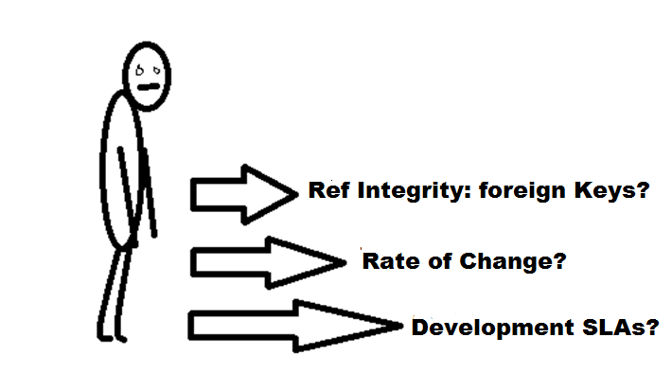
PERILS OF ENVIRONMENTS:
DATA HOMOGNEITY ACROSS ENVIRONMENTS
How close should environments be in terms of data?
SANDBOXAND INTEGRATION ENVIRONMENTS
hold the least amount of data. A rule of thumb: data set sufficient enough for developing functional requirements. Pros: speeds up development, cons: can’t accommodate all the test cases and needs constant data set assessments.
The QA/Staging should hold complete data set to allow for UAT and for performance and regression testing.
Break Fix environment holds data set and schema as close to production as possible to allow for speedy production issues resolutions.
PHYSICAL CONSTRAINTS
goes without saying. NO disk space means no disk space.

Slide 18
PERILS OF ENVIRONMENTS CONT.:
ENVIRONMENT SLAs
is development around the clock with international development team,
24/7 or only happens in one place with 8 hours development day/time?
RATE OF REFRESHES
depends on whether we do continuous deployments or scheduled releases
DATA RETENTION
how much and often transactional data gets purged?
SCHEMA MANAGEMENT
Schema/data in source control? Are deployments automated including data?
Are there specific structures that support metadata?

Slide 19
DATA LOAD SOLUTION STRATEGIES
CONSTRAINTS
Operational requirements for
data availability
data consistency
performance
data integrity
Development Requirements for:
development time
skill sets
Environmental
Monetary (space and processors)
Political (we just do not want to use third party)
ARCHITECTURAL
PATTERNS
Backup/Load
ETL Solutions (different kinds)
IN-CLOUD PATTERN - NEW
VM Provisioning/IMAGE

Slide 20
QA/STAGING/BREAK FIX ENVIRONMENTS
BE AWARE !
Backup/Load takes time. Count on it.
Refactoring takes time. Count on it.
ETL takes time. Count on it.
Masking has its own architectures.
Chose the one appropriate.

Slide 21
USED TOOLS AND OTHER TOOLS THAT HELP
What I used:
SQL Server, SSMS, SSIS, Data Quality Services, TFS, VS, Visio
If you do not have VS and TFS:
Red Gate: SQL Compare, SQL Data Compare,SQL Data Generator, SQL Source Control
Embarcadero: E/R Studio, DB Change Manager
HUSH-HUSH Masking components for ETL architectures from FSI

